Slide 1

SportsBuddy – find Local Sports Events & Teammates
Domain: Frontend Development
Build with: React, Firebase, Firestore
  By: Krishna Rajeshbhai Khokhariya

Slide 2
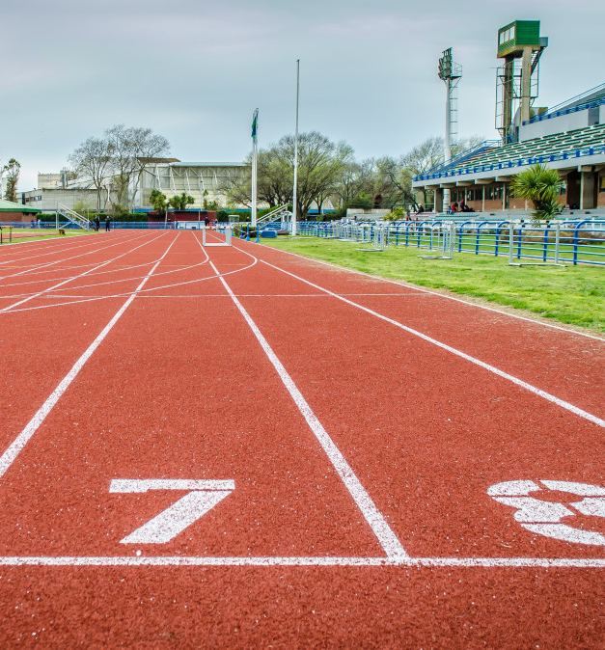
Introduction
SportsBuddy is a web application that connects people through local sports events.
Users can:
  Discover sports events in their city
  Send join requests and become attendees
  Match with players based on sport and location
Admins can:
  Manage sports, cities, areas, and events
  Monitor logs and system activity
The project demonstrates how modern web technologies can be used to solve a real-world event & teammate matching problem.

Slide 3
Objective
Main Objective
To build a web application that allows users to:
  Find local sports events
  Connect with teammates who share similar sports interests
  Manage their participation and activities efficiently
Specific Objectives
Enable users to:
  Register, login, and manage their sports profile
  Create, edit, and delete their own events
  Send join requests and leave events
Enable admins to:
  Manage sports, cities, areas, events and logs from a central dashboard
  Monitor activities and maintain system integrity

Slide 4

Problem Statement
Many people want to play sports but:
  Don’t know where local games are happening
  Struggle to find teammates with similar interests and skill levels
There is a need for a platform where:
  Users can discover sports events near them
  Event creators can manage attendees
  Admins can control system data and monitor activity
Goal
Build a system that helps users discover, manage, and join sports events, and helps admins maintain consistent data and control.

Slide 5
Techniques Used
Web Application Design
Component-based UI using React
Responsive layout with Tailwind CSS
State Management
React Context API for auth & global state
Custom hooks for popups and confirmation dialogs
Authentication & Security
Firebase Authentication (email + password + reset)
Firestore security rules for users, events, and admin data
Data Modelling
Separate collections for users, events, sports, cities, areas, logs
Subcollection events/{eventId}/attendees for join requests
Event Matching Logic
Categorization of attendees into:
Star Match (same sport + same city)
Sports Match (same sport)
City Match (same city)
Not Matched

Slide 6
Tools & Tech Stack
Frontend
React + Vite – fast development and component-based UI
Tailwind CSS – utility-first, responsive styling
Backend & Data
Firebase Authentication – login, register, reset password
Firestore Database – stores:
Users
Events
Join Requests (attendees)
Sports, Cities, Areas
Logs
Other
Firebase Cloud Messaging (FCM) – local event notifications
React Context API – global auth and app state
Custom Hooks – modular logic for modals, confirmations, etc.

Slide 7
Project Workflow
User Registration & Login
  User creates account with basic details
  Login via Firebase Auth
Profile & Preferences
  User sets city, area, sports interests, and skill level
Event Management
  Users create events with:
      Sport, date/time, city, area, skill, description
  Events visible to all users in the system under Events tab

Slide 8
Project Workflow (Continue…)
4. Join Requests & Attendees
  User sends join request for an event
  Event creator reviews and Accepts / Rejects requests
  Accepted users appear as joined attendees
5. Admin Management
  Admin dashboard shows stats + logs
  Admin manages sports, cities, areas, events
6. Notifications
  Users receive notifications for:
    Request accepted / rejected
    Event-related updates (as configured)

Slide 9

User Features
Authentication & Profile
  Register, Login & Reset Password
  Profile with name, city, area, sports interests, skill level
Dashboard Tabs
  Created – events created by the user
  Pending – join requests sent (waiting for approval)
  Joined – events where the user is accepted
Event Interaction
  View all events from all users in Events page
  Open Event Detail page on card click:
    See full event info and buttons:
      If not creator: Send Join Request
      If already joined: Leave Event
      If creator: Edit / Delete / View Attendees
Notifications
  Request accepted / rejected
  Event-related notifications (via FCM / Firestore-based notification logic)

Slide 10

Admin Features
Admin Access
  Admin added manually (email + password script in Firestore)
  Admin logs in through the same login page but sees Admin Dashboard
Admin Dashboard
  Total Users, Sports, Cities, Areas
  Recent 5 Events
  Event date graph
  Recent system logs
Admin Management
  CRUD for:
    Sports – used in dropdowns
    Cities – used for event & profile locations
    Areas – mapped to cities
    Events – admin can edit/delete any event
View system logs:
    Event created/updated/deleted
    Join/leave requests
    Admin operations

Slide 11
Testing Overview
Functional Testing
  User-side:
    Register, login, logout, password reset
    Profile update
    Create / edit / delete event
    Join and leave event
  Admin-side:
    Login as admin
    CRUD on sports/cities/areas/events
    View logs and dashboard stats
Workflow Testing
  End-to-end:
    User creates event
    Other user sends join request
    Creator accepts / rejects
    Joined event appears under “Joined” tab
Security & Rules (High Level)
  Checked Firestore rules:
    Only authenticated users can access data
    Only event creator/admin can modify event
    Users can only update their own profile

Slide 12
Testing Summary & Key Findings
Tested Scenarios:
  Register - login - dashboard redirect
  User creates event - appears in Events list
  Another user sends join request - event creator sees request
  Creator accepts request - attendee moves to Joined state and get notification
  Creator rejects request - attendee removed from pending & attendees array and get notification
  Admin edits/deletes events - reflected in user views
  Invalid operations (unauthorized edit/delete) blocked by Firestore rules
Key Observations
  Application flow works correctly for Standard user journeys and Admin management tasks
  Matching categories display correctly.

Slide 13
Results
Users can successfully:
  Register/Login/ Reset Password
  Create/edit/delete their own events
  Send join request and leave events
Event creator can view categorized attendees and can Accept/Reject request
Admin can:
  Manage all master data and edit/delete events
  Monitor logs and system activity
Clean layout with Tailwind CSS, user dashboard with clear tabs (Created/Pending/Joined Events).
Attendees categorized accordingly.

Slide 14
Future Improvement
To expand SportsBuddy into a more advanced and engaging platform, the following enhancements are planned:
  In-App chat System between event creators and attendees.
  Email reminders and event confirmation mails.
  Smart buddy recommendation system
  Profile picture and richer user profiles

Slide 15
Conclusion
SportsBuddy successfully delivers a complete system for discovering sports events, connecting players, and managing activities.
The app provides:
Users: event discovery, profile management, join requests, attendee matching.
Event creators: categorized attendee requests (Star/Sport/City Match) and full request control.
Admins: dashboard analytics, CRUD for sports/cities/areas/events, and system logs.
Built with React, Tailwind, Firebase Auth, and Firestore, the platform is responsive, secure, and scalable.
SportsBuddy demonstrates how modern web technologies can solve real-world sports coordination challenges efficiently.

